Slide 1
Lesson 1 Introducing Python
1

Slide 2
Introducing Python
1.1 Introduction
1.2 Working with the Python Interactive Shell
1.3 Writing and Running Simple Scripts
1.4 Variables
1.5 User Input, Comments, and Indentations
1.6 Summary
2

Slide 3
Check for Python using cmd
Display current Directory
Changing CWD
Listing all files in a directory
Clear the screen
Check if python is installed
Run a python script
Navigate to python.org

Slide 4
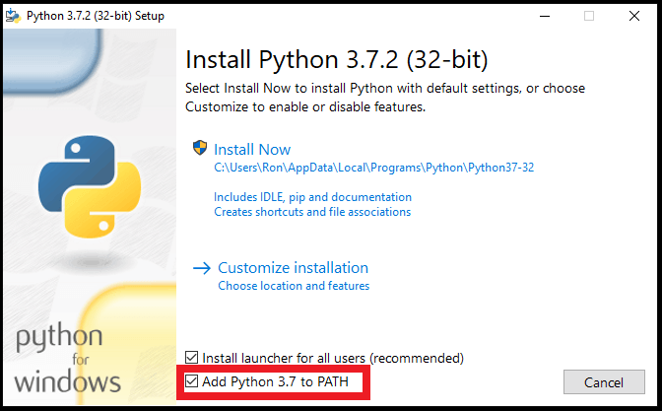
Install Python

Slide 5
Working with python code editors
IDLE- Comes with Python download.
IDE – Most used option, integrated with other languages
Jupyter Notebooks – Data Science, Learning
Text Editor- very basic, not great for writing and editing code.
We will discuss when to use each, and which one we will use for our learning.

Slide 6
Working with GitHUB
IDLE- Comes with Python download.
IDE – Most used option, integrated with other languages
Jupyter Notebooks – Data Science, Learning
Text Editor- very basic, not great for writing and editing code.
We will discuss when to use each, and which one we will use for our learning.

Slide 7
1.1 Introduction
Python is a high-level and general-purpose programming language.
It is notorious for having a very simple "pseudocode-like" syntax that emphasizes readability and expressiveness.
Python not only makes code simpler to write but also easier to maintain.
Additionally, it features a vast standard library that is augmented by an even larger array of third-party libraries.
7

Slide 8
1.1 Introduction (continued)
Python also supports multiple paradigms, such as the following:
Object-oriented programming
Functional programming
Imperative programming
Procedural programming
8

Slide 9
1.2 Working with the Python Interactive Shell
Once the interactive shell opens, on the first line, you should see the Python version information.
The Python interactive shell can be thought of as just any other shell that interfaces with an operating system but, in this case, it interfaces with the Python interpreter.
9

Slide 10
1.3 Writing and Running Simple Scripts
1.3.1 Running a File Containing Invalid Commands
10

Slide 11
1.3 Writing and Running Simple Scripts (continued)
Running quick commands through the interactive shell is fun.
It comes in handy when you have a quick hypothesis that you want to test out or when you want to check whether a specific method exists for some data type.
Python allows you to run your instructions from a saved file.
A file containing Python instructions is called a module.
11

Slide 12
1.3.1 Running a File Containing Invalid Commands
Stack trace tells us useful things such as where the error happened, what kind of error it was, and what other calls were triggered along the way when you ran the command.
Stack traces should be read from bottom to top.
Another name for a stack trace is a traceback.
12

Slide 13
1.4 Variables
1.4.1 Values
1.4.2 Type Conversion
1.4.3 Multiple Assignment
1.4.4 Naming Identifiers and Reserved Words
1.4.5 Python Naming Conventions
13

Slide 14
1.4 Variables (continued)
Variables in Python can reference values of different data types such as strings, integers, floating-point values, Booleans, and different data types and data structures.
Python, in contrast to statically typed languages such as Java or C++, doesn't require you to pre-declare a variable's data type.
Variables determines the type during runtime.
14

Slide 15
1.4.1 Values
Python supports several different types of values.
You have encountered strings and numeric values such as integers.
15

Slide 16
1.4.2 Type Conversion
Sometimes, you may have a string with an integer inside it or an integer that you want to put in a string.
Python allows you to convert string type values to integer type values and vice versa.
16

Slide 17
1.4.3 Multiple Assignment
In Python, you can also assign multiple variables in one statement.
The Python interpreter raises an error and tells us it didn't get enough values to assign to the variables you declared in the statement.
17

Slide 18
1.4.4 Naming Identifiers and Reserved Words
Python, like other languages, has a couple of rules on naming identifiers such as variable names, class names, function names, module names, and other objects.
Some are strictly enforced by the interpreter, while others are simply by convention, and developers are at liberty to ignore them.
18

Slide 19
1.4.5 Python Naming Conventions
Python has several guidelines for naming identifiers that aren't enforced by the interpreter.
These guidelines are meant for consistent code and making it more readable.
19

Slide 20
1.4.5 Python Naming Conventions (continued)
It should be counterpointed that ignoring naming conventions eventually leads to a road of regret as they provide several advantages, such as the following:
Makes the code easier to read and understand for other programmers, since they'd find consistent and instantly recognizable patterns
Enhances clarity and reduces ambiguity
Makes automated refactoring easier, as the automation tools would have consistent patterns to look for
Provides additional information about the identifiers; for example, when you see a variable name in all caps, you immediately know that it is a constant
20

Slide 21
1.5 User Input, Comments, and Indentations
1.6.1 User Input from the Keyboard
1.6.2 Passing in a Prompt to the input Function
1.6.3 Using Different Input Data Types in your Program
1.6.4 Comments
1.6.5 Indentation
21

Slide 22
1.5.1 User Input from the Keyboard
Python has a very handy function for obtaining user keyboard input from the command-line interface (CLI) called input().
When called, this function allows the user to type the input into your program using their keyboard.
22

Slide 23
1.5.2 Passing in a Prompt to the input Function
You can pass a prompt to the input function to do this.
The prompt is written to standard output without a trailing newline and serves as a cue for the user to pass in their input.
23

Slide 24
1.5.3 Using Different Input Data Types in your Program
The values returned by the input function are always strings.
A string may not be the data type you're expecting in your program.
You can convert strings to integers using the built-in int function.
24

Slide 25
1.5.4 Comments
Comments are an integral part of programming.
Comments can be thought of as notes on the code that gives us more contextual information about it.
They can tell us why certain decisions were made, some improvements that can be made in the future, and also explain the business logic.
25

Slide 26
1.5.4 Comments (continued)
There are three different ways to write Python comments as follows:
Block and inline comments
Inline comments
Documentation strings
26

Slide 27
1.5.4 Comments (continued)
Here are three different ways to write Python comments:
Block and Inline Comments
Block and inline comments start with a pound sign (#).
A block comment comes in the line before the statement it annotates and is placed at the same indentation level.
Inline Comments
Inline comments are placed on the same line as the statement it annotates.
Documentation Strings
A documentation string or docstring for short is a literal string used as a Python comment.
27

Slide 28
1.5.5 Indentation
A block is a group of statements that are meant to be executed together.
Blocks are a fundamental aspect of modern programming languages since the flow of control structures are formed from blocks.
Blocks allow a set of statements to be executed as though they were a single statement.
28

Slide 29
1.6 Summary
In this presentation, we have learned that:
Python is a high-level and general-purpose programming language.
Running quick commands through the interactive shell are fun.
Stack traces should be read from bottom to top.
Comments are an integral part of programming.
Additional Study Resources
https://www.py4e.com/lessons
29

